Slide 1
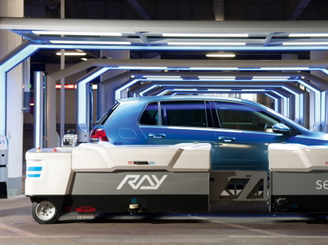
Autonomous Parking
Team A6
Notes:
Jason

Slide 2
Introduction & Background
Drivers spend an average of 17 hrs/year searching for parking and poorly executed parking maneuvers result in a significant number of expensive repairs and insurance claims.
If executed well autonomous parking in large parking facilities can optimize space usage and reduce the ~22% of city space that parking lots occupy
But it isn’t that easy, difficulties arise due to:
Complex Motion Planning
Sensor Limitations
Unpredictable Environment
Time Constraints

Slide 3
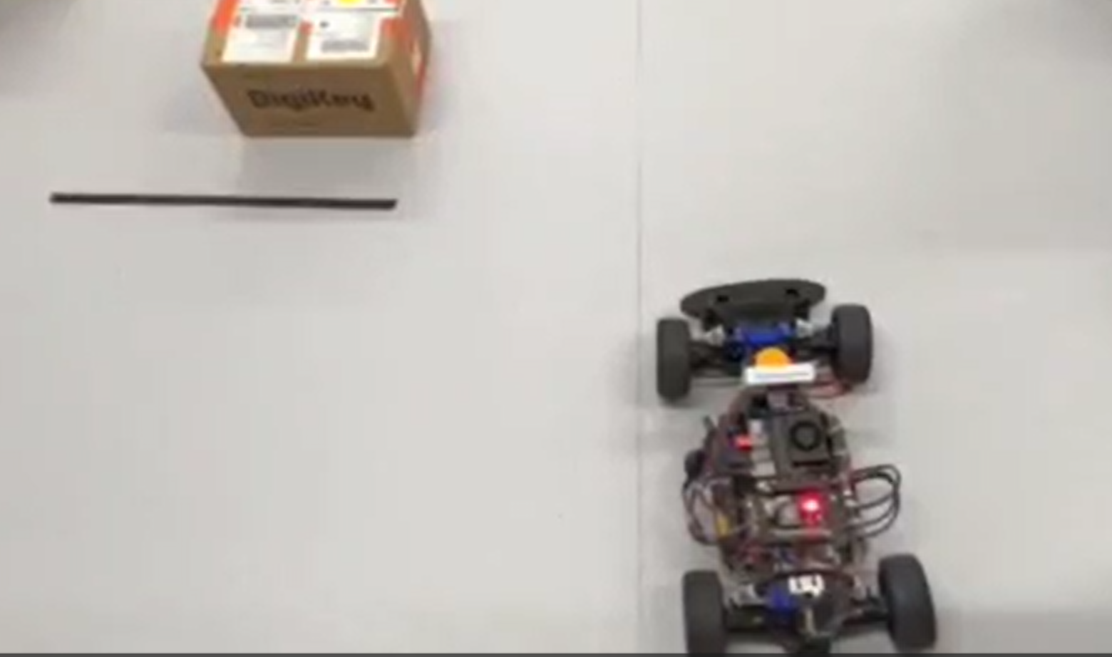
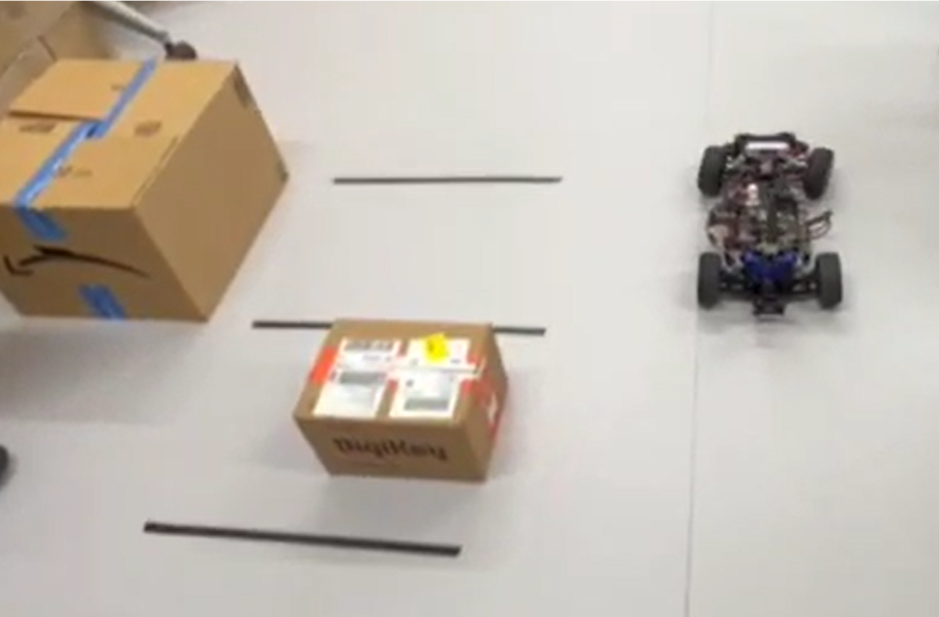
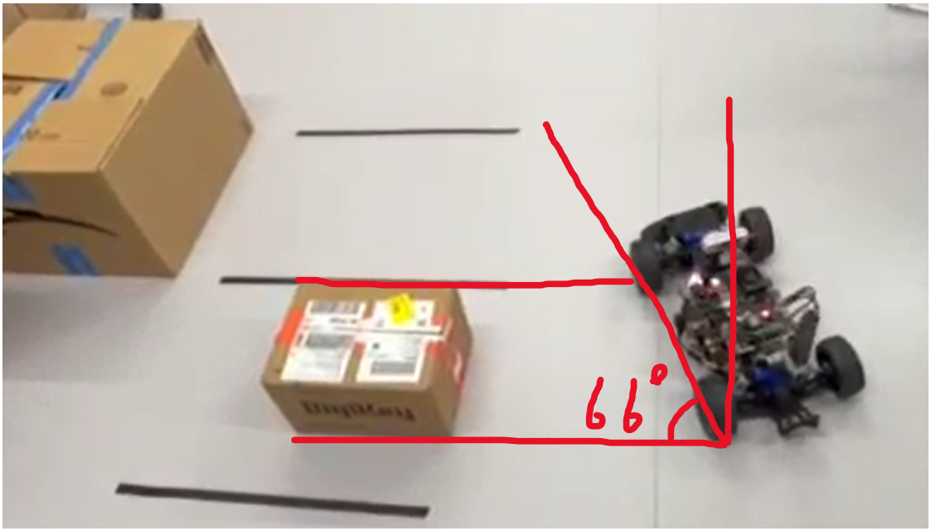
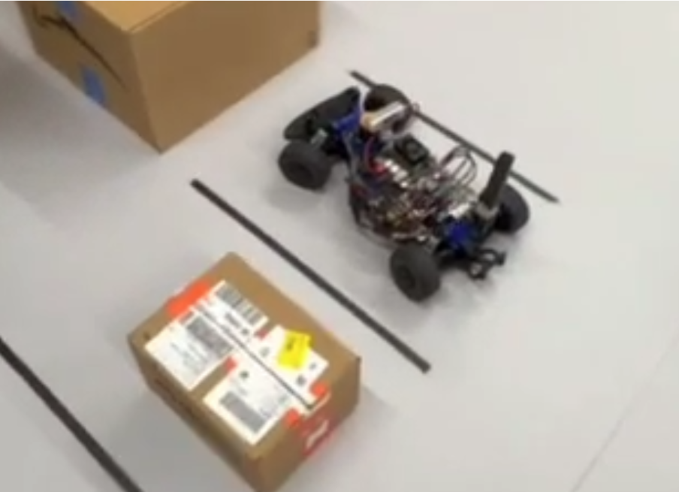
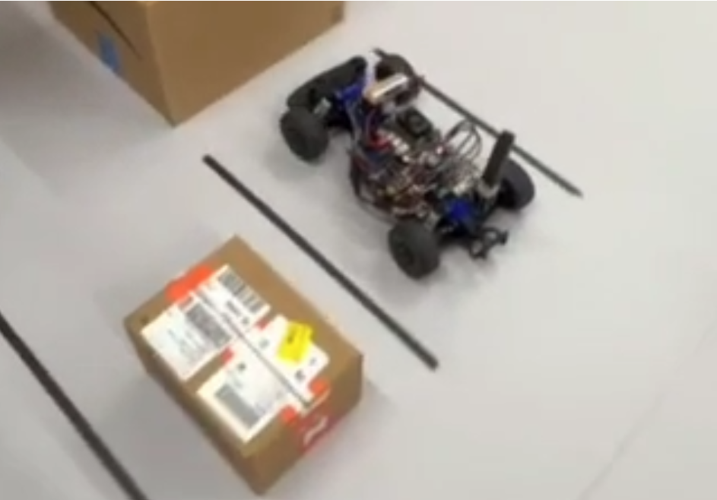
Our Project/Forward parking algorithm
4 state Finite State Machine
State 0: Initialization
State 1: Find the spot
State 2: Spot Alignment
State 3: Turning In
State 4: Halt and Straight

Slide 4
Key Assumptions & Limitations
A car is parked to the left of the desired stall
The parked car in the adjacent stall is fairly centered and straight
The car enters the parking lane fairly straight
Wall at the end of the parking stall (imitates a wheel stop)

Slide 5
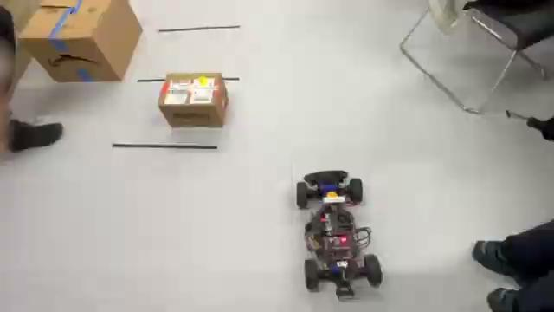
Demo

Slide 6
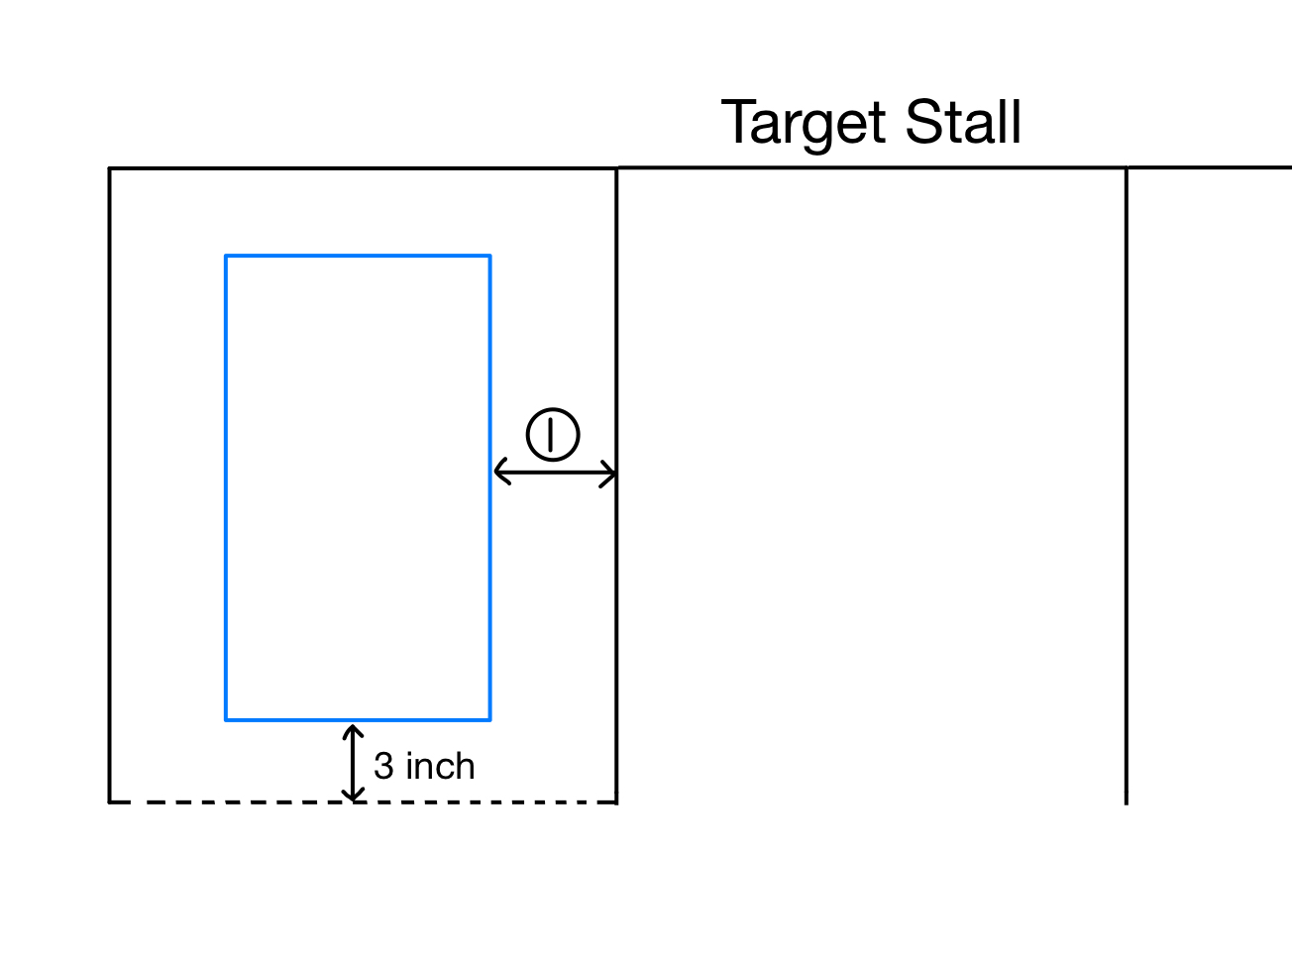
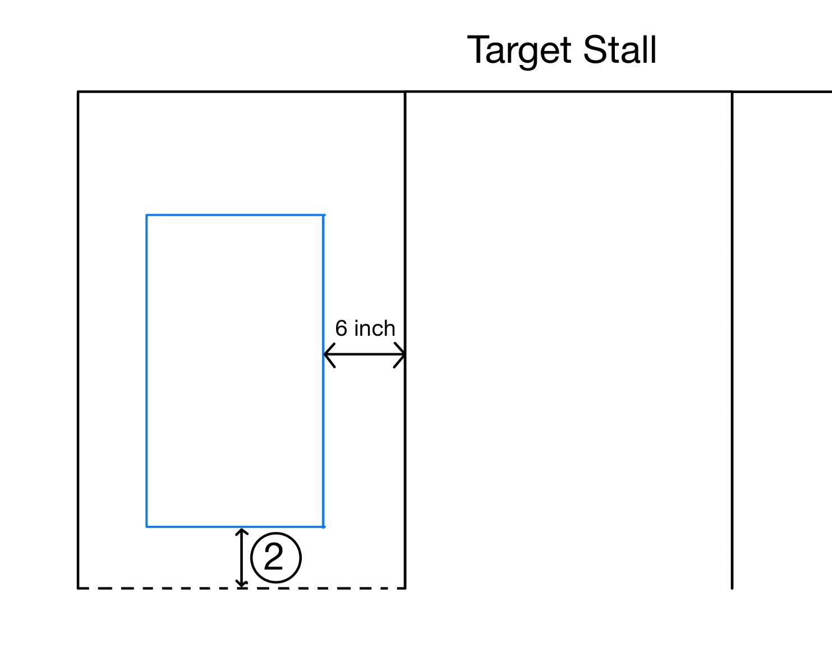
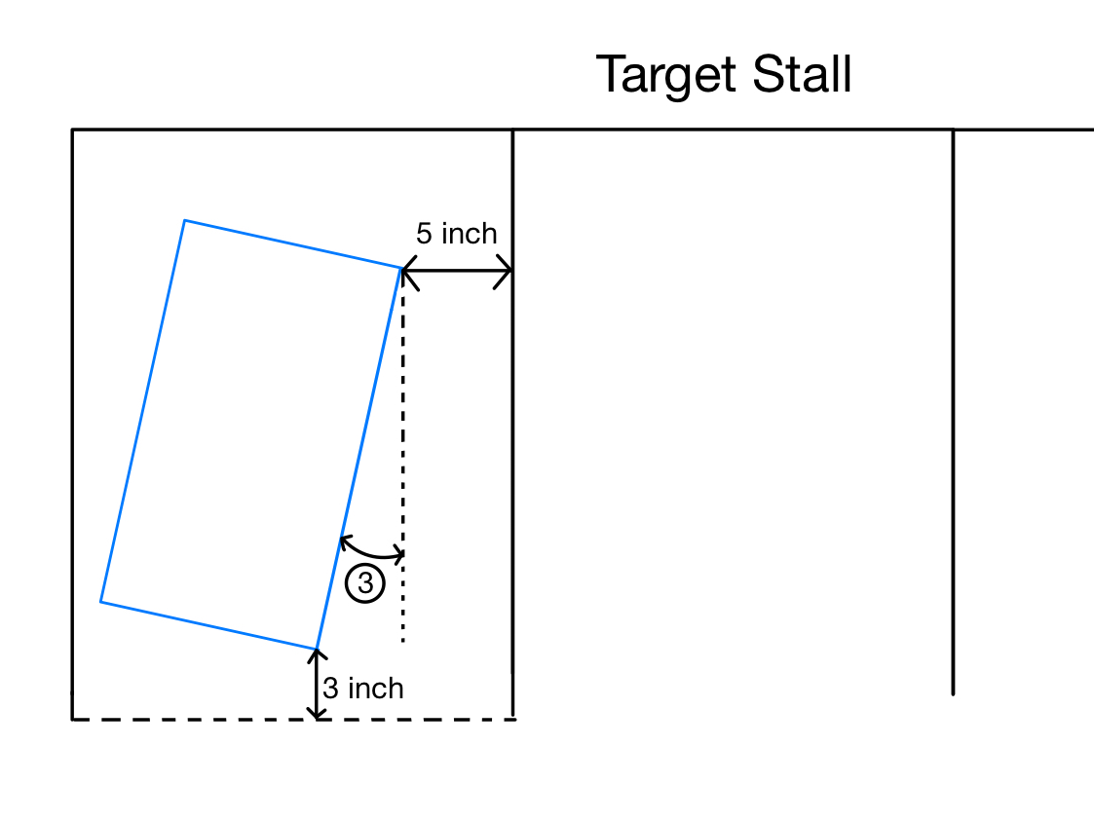
Tolerance Testing
Test 1: Lateral Offset
Test 2: Longitudinal Offset
Test 3: Angular Deviation
Test values: 13 degrees and 17 degrees
crossed the boundary line
wheels touching the line.
Test Range: 6 inch to 10 inch
4 out of 5 values resulted in successful parking within the stall.
Test Range: 3 inch to 8 inch
4 out of 6 values resulted in successful parking within the stall.

Slide 7
Other Approaches and Experiments
Parallel Parking
Path Planning
Reverse Parking
Utilizes LIDAR, side facing camera for detection, back camera for stopping
Equipment flexibility
Equipment shortage
Inconsistent Camera
Sampling based planner with 2D occupancy grid with LIDAR
Long planning time
Scan angle limitation
Complex and unpredictable
Utilizes a similar approach with a different angle, and constant stall detection
Inconsistent Edge Detection
Camera Angle

Slide 8

Other Approaches and Experiments
Camera only detection
Camera detect stalls using the tapes on the ground
Inconsistent Camera
False positive
Unreliable

Slide 9
Conclusion
Implemented a LIDAR-based forward parking system
Achieved high success rates across different conditions
Showed high level of robustness
Future Improvements

